Slide 1
Design Science Method
By Temtim Assefa
November 2014

Slide 2
Design Science Paradigm
It is problem-solving paradigm
Deals with the ‘design’ of artificial artifacts (i.e., IT artifacts) and creating something new that does not yet exist.
design is both a process (set of activities) of ‘creating something new’ and a product (i.e., the artifact that results out of this process)

Slide 3
Design Science
The objective of design science research is to acquire knowledge and understanding that enable the development and implementation of technology-based solutions to solve business problems.
Behavioral science with the development and justification of theories explaining or predicting phenomena that occur.
Each must inform the other.

Slide 4
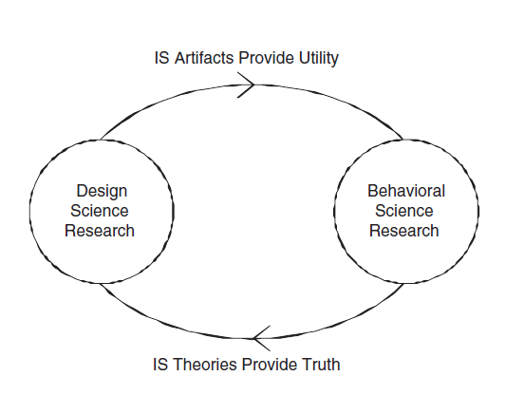
Relationship between behavioral and design science research

Slide 5
Design science …
Both behavioral and design science research challenge each other
For example, the technology acceptance model provides a theory that explains and predicts the acceptance of information technologies within organizations (Venkatesh 2000).
This theory challenges design-science researchers to create artifacts that enable organizations to overcome the acceptance problems predicted.

Slide 6
Methodology
Methodology is “a system of principles, practices, and procedures applied to a specific branch of knowledge
Such methodology help researchers to undertake valuable, rigorous, and publishable rese
Design science as a methodology would include three elements:
conceptual principles to define what is meant by design science research,
practice rules, and
a process for carrying out and presenting the research results

Slide 7
Conceptual Principles
“Design science…creates and evaluates IT artifacts intended to solve identified organizational problems
It involves a rigorous process to design artifacts to solve observed problems and contribute new knowledge
Artifacts may include constructs, models, methods, and instantiations
They also include social innovations or new properties of technical, social, and/or informational resources such as organization structure design

Slide 8
Practice Rules
Hevner et al. [20] provided seven guidelines (practice rules) that describe characteristics of well carried out design science research.
research must produce an “artifact created to address a problem
the artifact should be relevant to the solution of unsolved business problem
Its “utility, quality, and efficacy ” must be rigorously evaluated
Provide a verifiable contribution and

Slide 9
Practice …
Rigor must be applied in both the development of the artifact and its evaluation
The development of the artifact should be a search process that draws from existing theories and knowledge to come up with a solution to a defined problem
The research must be effectively communicated to appropriate audiences

Slide 10
Procedures
Refers to the standard steps design researcher should follow to develop an artifact that can solve the stated problem at the beginning.

Slide 11
Design research process
Metrics, Analysis
Knowledge
How to Knowledge
Disciplinary
Knowledge
Identify Problem & Motivate
Define Problem
Show Importance
Inference
Define Objectives of a Solution
What would a Better Artifact Accomplish?
Theory
Design & Development
Artifact
Demonstration
Find Suitable context
Use Artifact to Solve problem
Evaluation
Observe How Effective, efficient
Iterate Back to design
Communica-tion
Scholarly Publications
Professional
Publications
Process Iterations

Slide 12
Design Science Research outputs
Constructs
conceptual vocabulary of a problem/solution domain
Methods
algorithms and practices to perform a specific task
Algorithm is step-by-step procedure for calculations. Algorithms are used for calculation, data processing, information retrieval and automated reasoning

Slide 13
Outputs …
Models
a set of propositions or statements expressing relationships among constructs
abstractions and representations
Instantiations
constitute the realization of constructs, models and methods in a working system
implemented and prototype systems
Algorithmic codes with target language software
Better theories - artifact construction

Slide 14
1. Problem identification
A problem can be defined as the differences between a goal state and the current state of a system.
This phase define the specific research problem and justify the value of a solution
Help to develop an effective artifact and atomize the problem
Help to capture problem complexity
Justification of the solution motivates the researcher as well as audiences to accept the result
Resources Required
Knowledge of the state of the problem and the importance of its solution

Slide 15
Example 1: Problem identification
Distance learning puts learners in Isolation, lack of observation by teachers and more freedom to learners
Researchers in distance learning are interested to develop collaborative tools that supports student interactions
This is not sufficient, collaboration among tutors is also necessary for effective distance learning
No system so far that supports tutors

Slide 16
Example 2 – Amharic
Due to the advent of the Internet, many Amharic documents are now available online. Additionally, the popular search engine Google, has provided an Amharic interface. However, to date, no tolerant-retrieval mechanism based on spelling correction has been employed for Amharic; and even there is no published prior work regarding spelling correction for the Amharic language.

Slide 17
2. Define the objectives for a solution
objectives of a solution are derived from the problem definition and knowledge of what is possible and feasible.
It can be quantitative, e.g., terms in which a desirable solution would be better than current ones, such as increase, improve, etc or
qualitative, e.g., a description of how a new artifact is expected to support solutions to problems not solved before .
The objectives should be inferred rationally from the problem specification.
Resources required for task include knowledge of the state of problems and current solutions, if any, and their efficacy.

Slide 18
Objectives
Example 1 - collaborative tools
To develop a collaborative tools that support tutors in distance education
Example 2 – Amharic
to develop an Amharic spelling corrector to assist in the development of tolerant-retrieval Amharic search systems

Slide 19
3. Design and development
This phase creates the artifact, such as constructs, models, methods, or instantiations or “new properties of technical, social, and/or informational resources”
This activity includes determining the artifact’s desired functionality and its architecture and then creating the actual artifact
Resources required moving from objectives to design and development include knowledge of theory that can be brought to bear in a solution.

Slide 20
Design and Development ….
For example technology acceptance theory states that a new technology will be accepted if it is useful to the task and easy to use during operation
This guides us to define functional and non functional requirements when we develop a new artifact
Behaviorist theory states that learning material should be decomposed from simple to complex learning materials to facilitate learning
The implication for e-learning design is that our e-learning content should decomposed into simpler components and then reorganized by its complexity to facilitate computer based learning materials

Slide 21
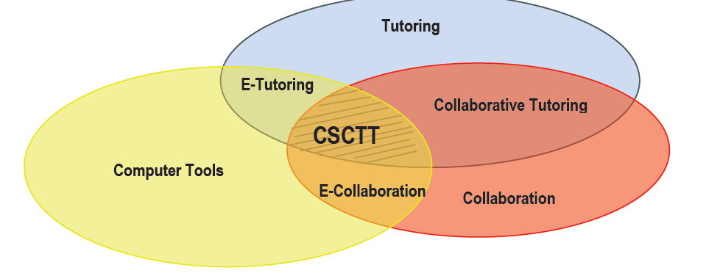
Example 1 – Computer Supported Collaborative tutoring tool (CSCTT)

Slide 22
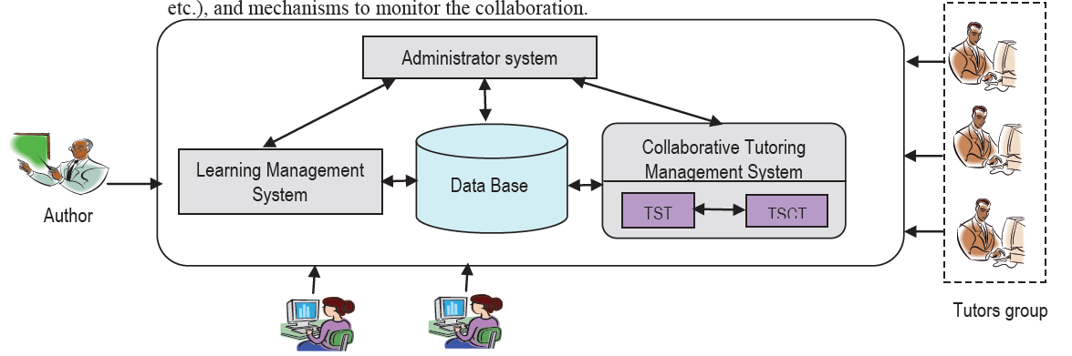
CSCTT Architecture

Slide 23
Solution Description
This system consists of a manager of collaboration requests that manages the requests issued by the tutor.
when the tutor receives an assistance request from a learner, this tutor has the opportunity to work in group and collaborate with another member of his group who has the specified role or tutor (according to the type of assistance request).

Slide 24
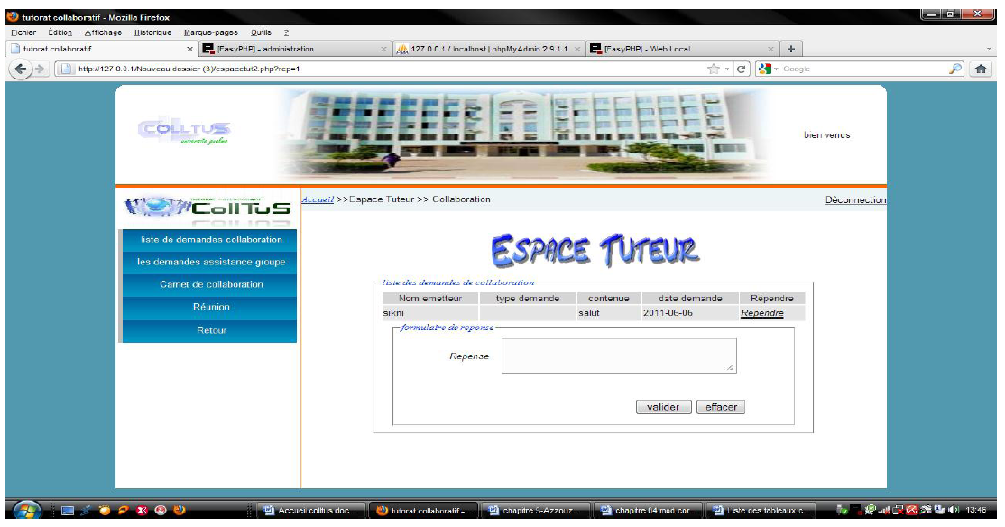
Example - Demonstration

Slide 25
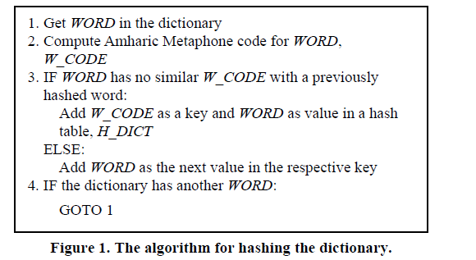
Example 2 – Construction of Amharic Dictionary

Slide 26
Get Word
Compute Amharic Metaphone code, W_Code
If no similar W_code
Yes
No
Add W_code as a key and Word value
Add W_code as Next Value
If dictionary has another word
Yes

Slide 27
Example 2….
As a further refinement, the algorithm tries to suggest replacements for a misspelled word by splitting it into two parts, and then checks whether the pair of words are valid Amharic words. If so, they are offered as a suggestion.
The assumption behind this step is that users may have failed to type a blank space between words.

Slide 28
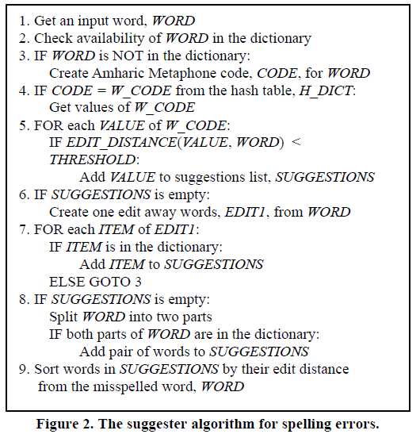

Slide 29
4. Demonstration and Evaluation
Demonstration is a single act to prove that the idea works to solve one or all aspects of the problem
This could involve its use in experimentation, simulation, case study, proof, or other appropriate activity
Resource required
Knowledge of how to use the artifact to solve the problem

Slide 30
Evaluation ….
Evaluation refers to the observation and measurement of how well the artifact supports a solution to the problem
This activity involves comparing the objectives of a solution to actual observed results from use of the artifact in the demonstration
It requires knowledge of relevant metrics and analysis techniques

Slide 31
Design Science Framework
It describes the necessary elements to be considered during design of new artifact
The main pillars are
Environment
Design process
Existing knowledge base

Slide 32
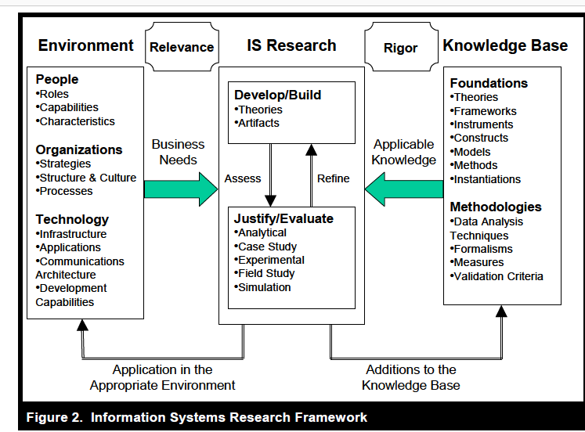

Slide 33
Relevance cycle
Improves the environment by creating new and innovative artifacts and processes
An application domain consists of the people, organizational systems, and technical systems that interact to work toward a goal
Identifying and representing opportunities and problems in an actual application environment
Also defines acceptance criteria for the ultimate evaluation of the research results
Outputs must be returned into the environment for study and evaluation in the application domain
Results of the field testing will determine additional iterations

Slide 34
Rigor cycle
Draws from a vast knowledge base of scientific theories and engineering methods
Provides past knowledge to the research project to ensure its innovation
Reference to KB helps to show clear contribution of the research and not use of known design processes and appropriation of known design artifacts.
Depends on the researcher’s skills in the selection and application of the appropriate theories and methods for constructing and evaluating the artifact

Slide 35
Rigour …
Contributions include
additions or extensions to the original theories and methods made during the research,
the new artifacts (design products and processes), and
all experiences gained from performing the iterative design cycles and
field testing the artifact in the application environment.

Slide 36
Design Cycle
The heart of any design science research
iterates more rapidly between the construction of an artifact, its evaluation, and subsequent feedback to refine the design further
Simon (1996) describes the nature of this cycle as generating design alternatives and evaluating the alternatives against requirements until a satisfactory design is achieved
Necessary to know dependencies of the design cycle on the other two cycles while appreciating its relative independence
Artifacts must be rigorously and thoroughly tested in laboratory and experimental situations before releasing them

Slide 37
Further Case study
Research project: A Software Reuse Measure Developed at MBA Technologies
MBA Technologies was a medium-size Phoenix based software developer that specialized in the development of business process and accounting systems; the company obtained high reuse in its software development by leveraging of existing components that were mapped to an enterprise-level model.

Slide 38
Problem Definition
Most software development companies do not assess their success at reuse, even if they are actively pursuing an increase in the reuse of software artifacts through a formal reuse program. Thus, many software developers invest in corporate reuse programs without being able to evaluate whether their programs lead to an increase of reuse. Also, without a formal reuse measure they are not able to identify differences in reuse success among projects. The development and subsequent dissemination of a reuse measure that can be applied to enterprise level model-based reuse efforts would enable the researchers to conduct an in-depth analysis of MBA Technologies’ reuse success across multiple completed projects.

Slide 39
Objective solution
The objective was to develop a reuse rate measure that allowed the researchers to assess the reuse rate, or reuse percentage, of the participating organization for subsequent case study research. Such a measure would represent the development effort that was reused from existing code as a percentage of the total project development effort.
The measure was to be developed in a generic fashion that would ensure its applicability to settings other than the participating organization as well.

Slide 40
Design and Development
The software measurement literature was used to evaluate the suitability of potential size or complexity measures.
The concept of the reuse rate was obtained from software reuse literature, which served as the theoretical foundation for the development of the reuse metric
The reuse rate was defined as the reused development effort divided by the total development effort of the project. The metric artifact operationalized this high-level definition by formalizing how to count reused development effort and total development effort in the context of an enterprise-level model-based reuse setting. This operationalization required making decisions on how to count duplicate use of code stubs, modified reused components, and other special cases.
These decisions and assessments were made based on prior findings in the software reuse literature.

Slide 41
Demonstration
Assessing and reporting the reuse rate for a project in the participating organization demonstrated the measure’s feasibility and efficacy
Details about the company’s development environment, including a classification of code into three levels of abstraction, the use of generated code, specifics about the component design, and the classification of certain code stubs, were obtained through structured interviews.
Size measures in thousands of lines of code (KLOC) and the classification of code stubs at the lowest level of abstraction were obtained directly from source code. The measure yielded separate reuse percentages for code on three layers of abstraction, according to the organization’s classification, as well as a weighted total reuse percentage. Further, reused generated code was reported separately

Slide 42
Evaluation
In the subsequent case study, the measure was used to assess the reuse rates of five projects at MBA Technologies, with sizes varying from 57 KLOC to 143 KLOC.
The assessed total project reuse rate for non-generated code ranged from 50.5% to 76.0%. In structured interviews, developers were asked to assess the projects’ reuse rates without prior knowledge of the measured results. The relative assessments were consistent with the actual measurements.

Slide 43
Communication
The contributions of this effort were disseminated in peer reviewed scholarly publications.
The development of the reuse rate measure was published in Information & Management [42].

Slide 44
Contribution
The research artifacts resulting from this study included a designed and evaluated formal measure and metric for software reuse rates.
These artifacts provide a valid and effective measure for use in development practice at the organizational and project level for evaluation and assessment of the effectiveness and performance of software reuse efforts

Slide 45
Checklist for Design Science
What is the research question (design requirements)?
What is the artifact? How is the artifact represented?
What design processes (search heuristics) will be used to build the artifact?
How are the artifact and the design processes grounded by the knowledge base? What, if any, theories support the artifact design and the design process?
What evaluations are performed during the internal design cycles? What design improvements are identified during each design cycle?
How is the artifact introduced into the application environment and how is it field tested? What metrics are used to demonstrate artifact utility and improvement over previous artifacts?
What new knowledge is added to the knowledge base and in what form (e.g., peer-reviewed literature, meta-artifacts, new theory, new method)?
Has the research question been satisfactorily addressed?

Slide 47
A mental model is a "small-scale [model]" of reality …[that] can be
constructed from perception, imagination, or the comprehension of discourse. [Mental models]
are akin to architects' models or to physicists' diagrams in that their structure is analogous to the
structure of the situation that they represent, unlike, say, the structure of logical forms used in
formal rule theories [25].”

